Slide 1

Unicycle project

Slide 2
Outline
Introduction
Framework
Diff. Flatn L & NL
Outpput state
parking

Slide 3
Introduction: the "urban mobility challenge"
Problem: An autonomous guided vehicle (AGV) has to travel along a closed circuit avoiding the other AGVs that are parked along the path; at the completion of one lap, the AGV has to get off the circuit and park at the box
PROJECT OBJECTIVES:
Track a closed trajectory
Avoid obstacles on the trajectory
After performing one lap, reach an empty parking lot

Slide 4
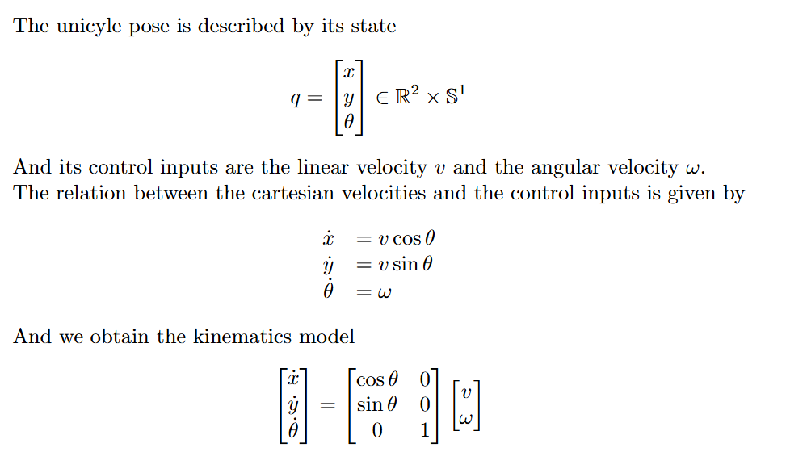
Framework: unicycle
θ
y
The AGV used in the project is a unicycle, a planar vehicle which is described by its state
x

Slide 5
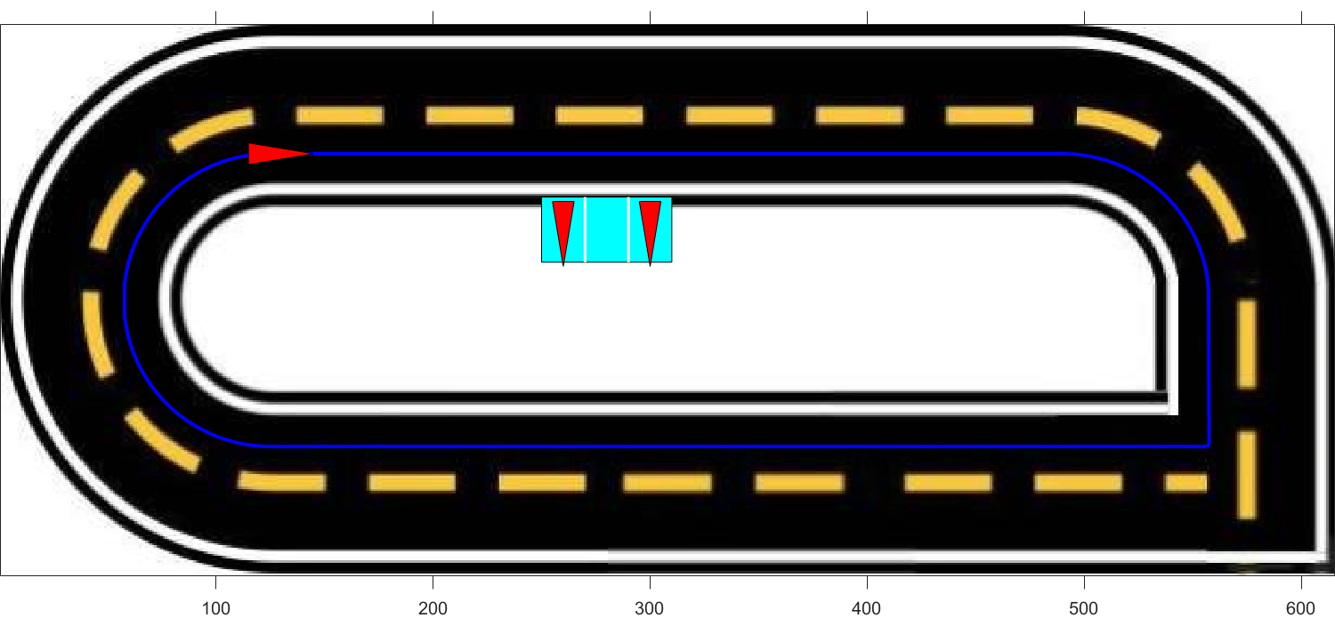
Framework: trajectory
To design the desired trajectory, a series of waypoints was defined. These waypoints were then interpolated using cubic spline interpolation to ensure a continuous path
To test controllers' functionalities on a non-continuous path, a sharp square-angle turn is added to the path

Slide 6
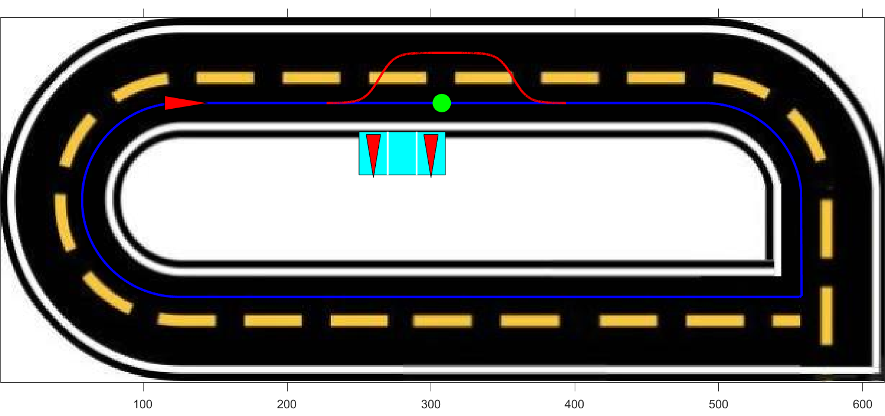
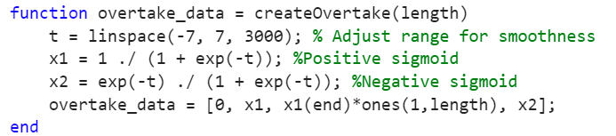
Obstacle avoidance
The unicyle after detecting the obstacle progressively reaches the second lane, after overtaking the obstacle it progressively returns to the first lane
To ensure a smooth and continuous trajectory during the changing lane procedure a sigmoid function has been used

Slide 7
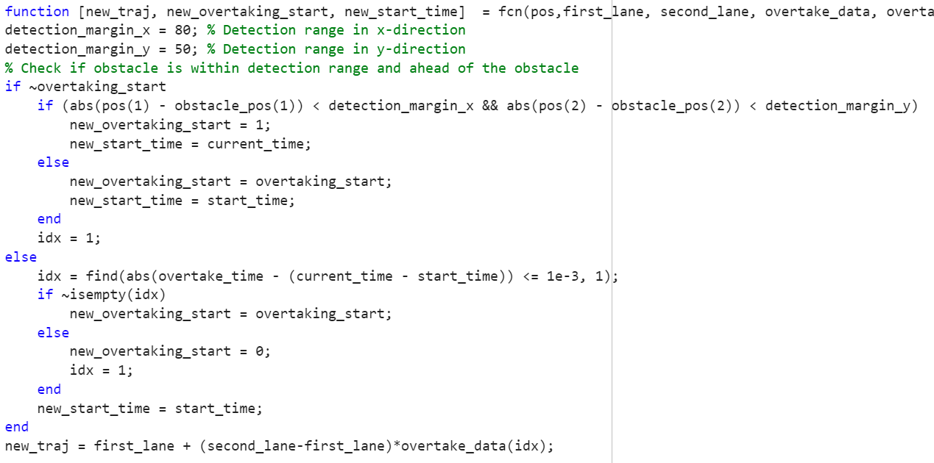
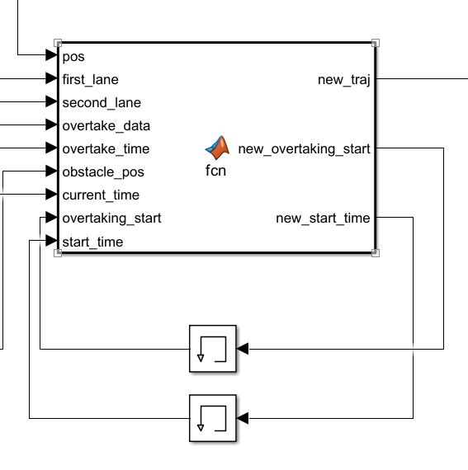
Obstacle avoidance

Slide 8
TRAJECTORY TRACKING - STATE ERROR FEEDBACK

Slide 9
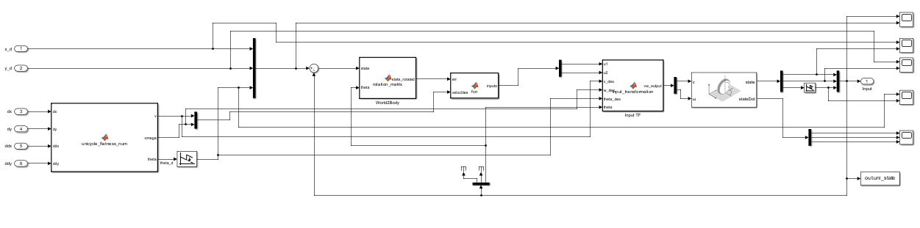
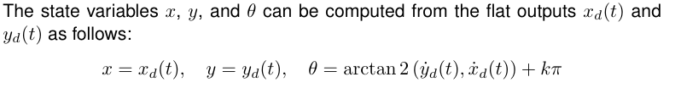
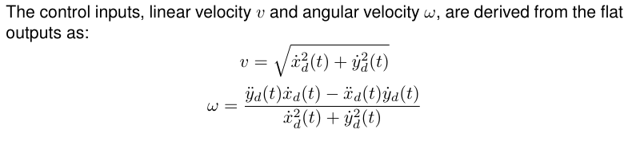
Linear case
Notes:
THINGS TO SAY:
General overview of the structure
Vdes != 0 , so persistent trajectory (even more important later on with k2 (v is at the denom)
w depends on v^2 basically, so we must have v !=0, furthermore later on , k2=num/vd so vd!=0 otherwise k2 explodes, we will add a saturation on it
We can not guarantee asymp convergence cause system TV, but we do have convergence property cause we are doing rectilinear and semicircular motions so someway we are covered by good convergence properties
explain the wrap / unwrap:
we used the unwrap to normalize theta angle, so we don't have the discontinuity going from 2pi to 0

Slide 10
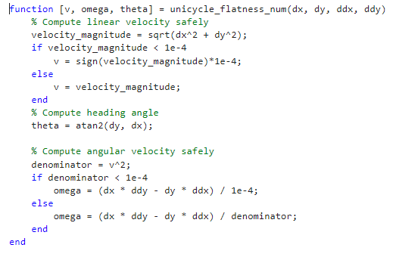
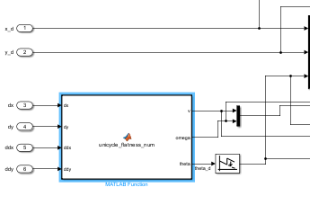
Avoiding division by zero
differential flatness block

Slide 11
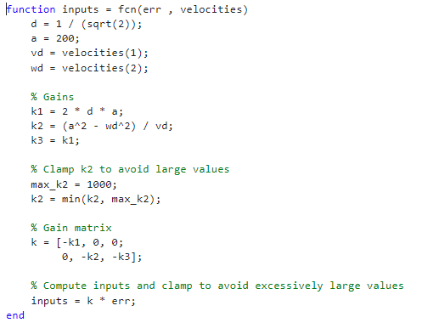
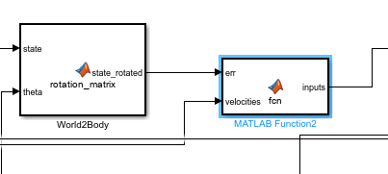
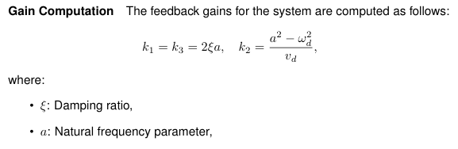
Gains & Parameters
Notes:
Say something about eigenvalues, thanks to this ki we know the eigs are on the LHS

Slide 12
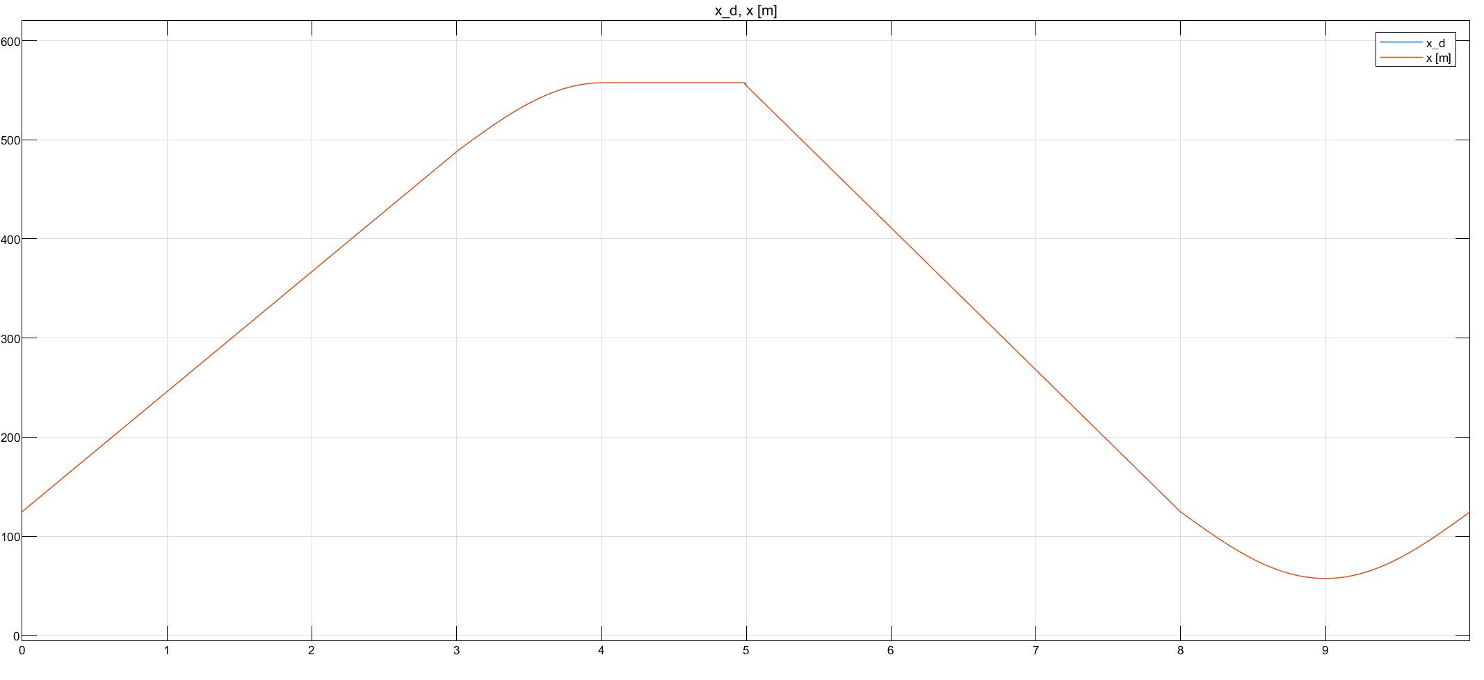
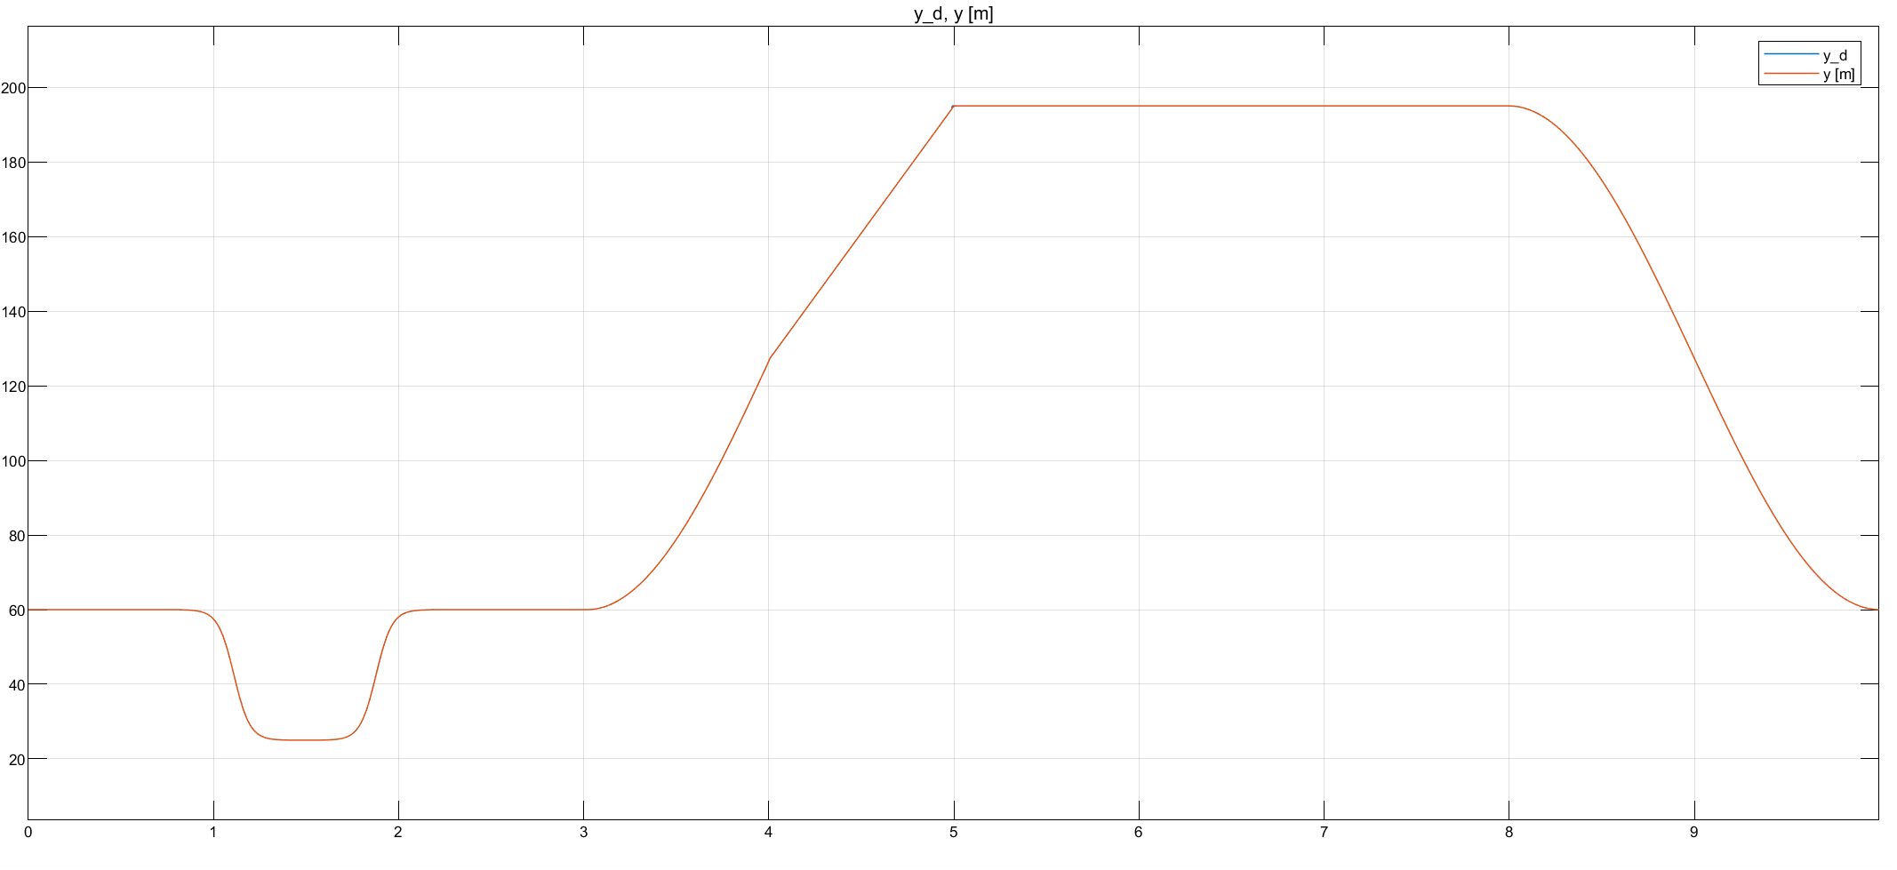

Slide 13
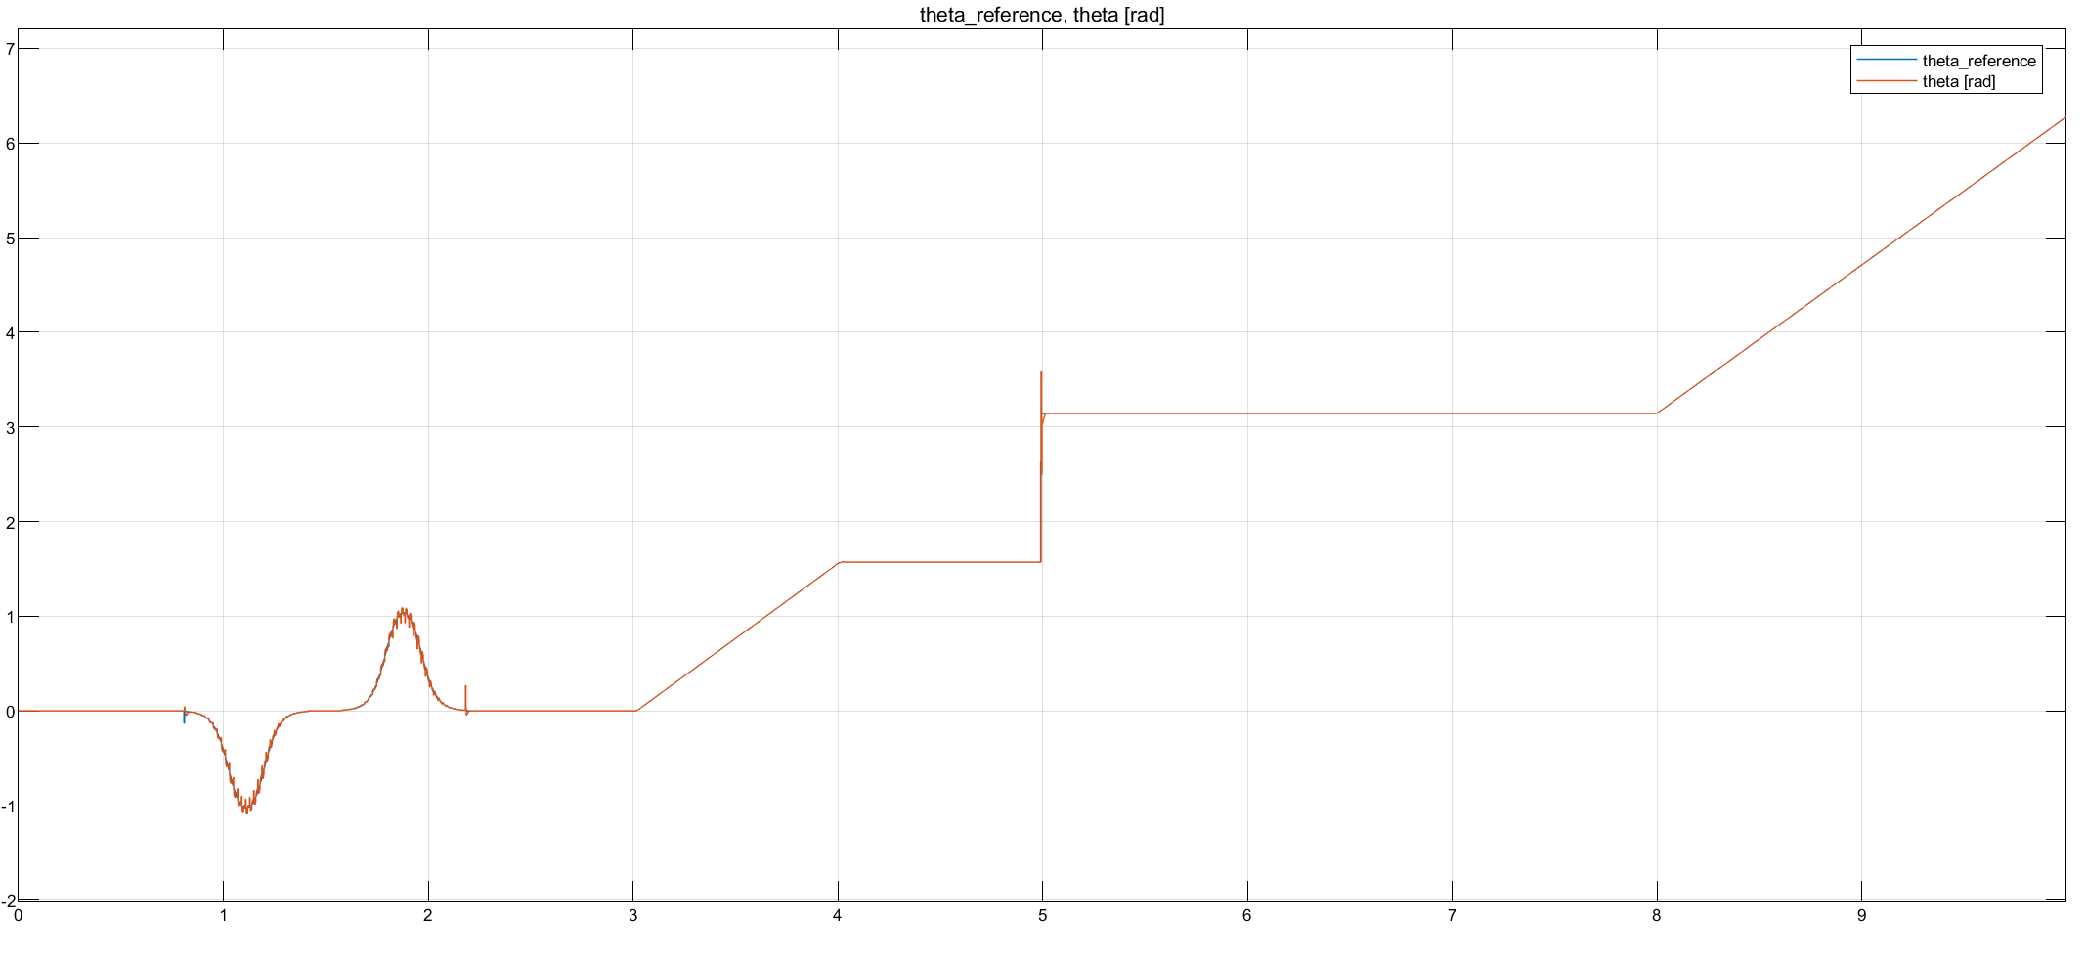
Cambia theta_ref in theta_d o cambia x_d , y_d e controlla che siamo giusto lineare questo grafico

Slide 14
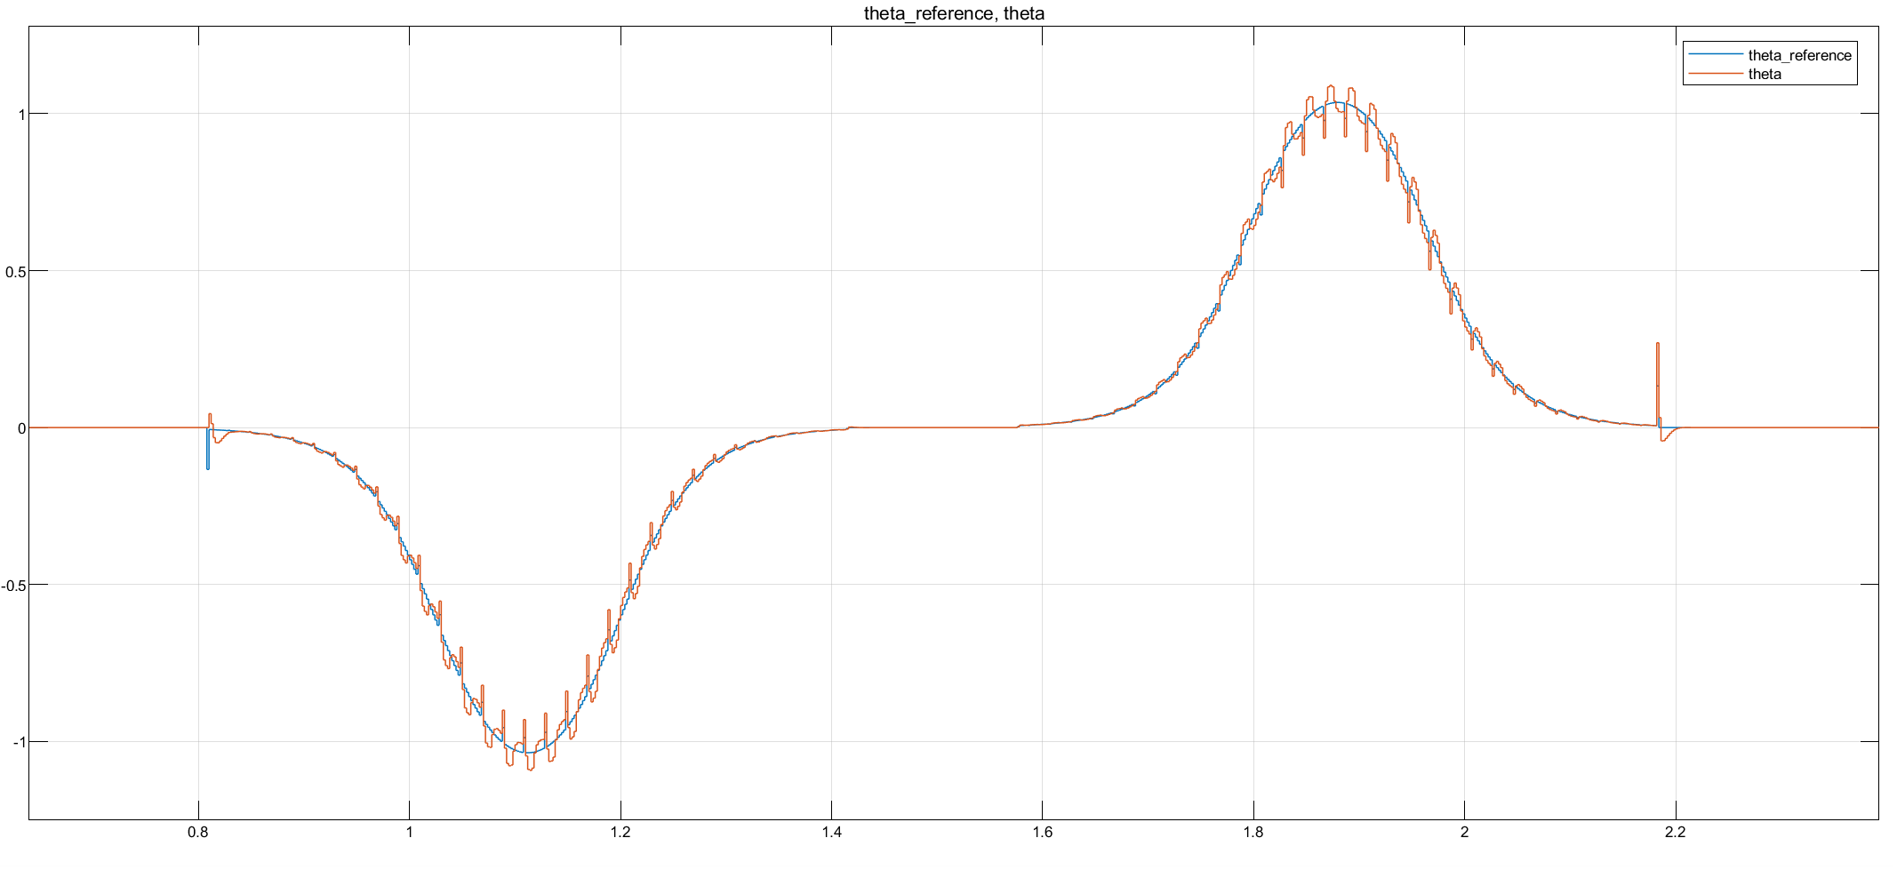

Slide 15
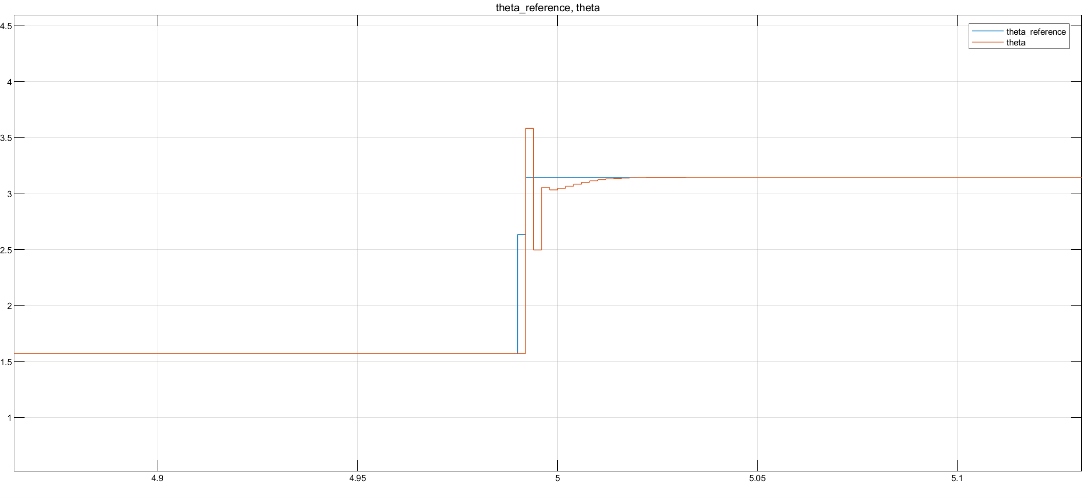
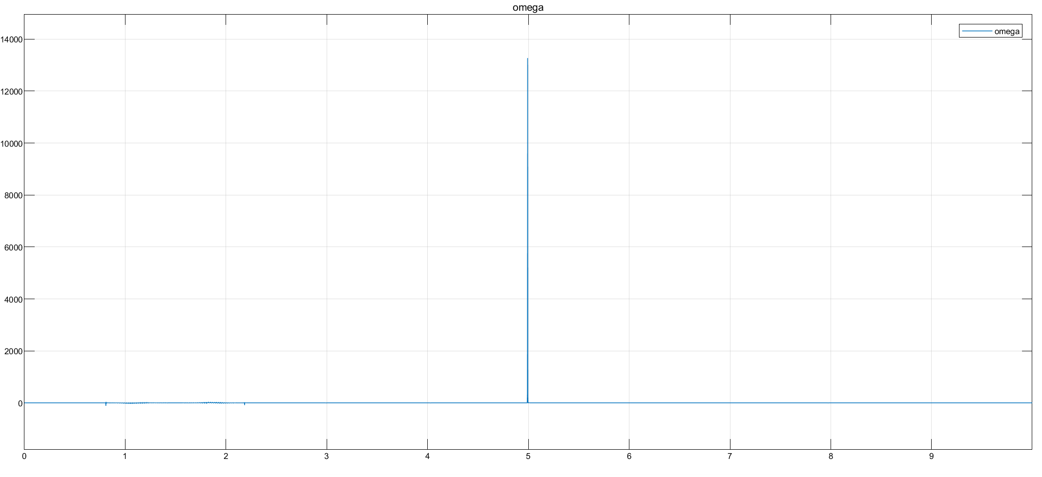
Focus on sharp curve
As expected from theory, differential flatness block should not be able to compute the input velocities when reaching a non differentiable part of the trajectory. Indeed, impulses in both velocities arises, with stronger effect in omega, (its computation is based on the second order derivative).
Nonetheless, thanks to Simulink implementation of the derivative we have been able to overcome the problme and to finish the simulation anyway.

Slide 16
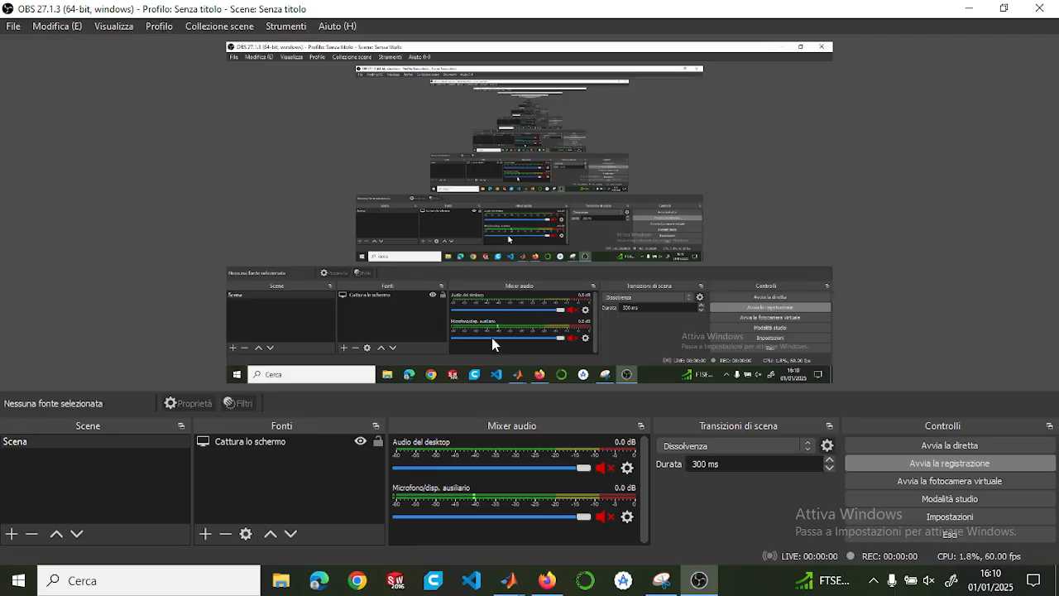
Video
Sistemare e tagliare video

Slide 17
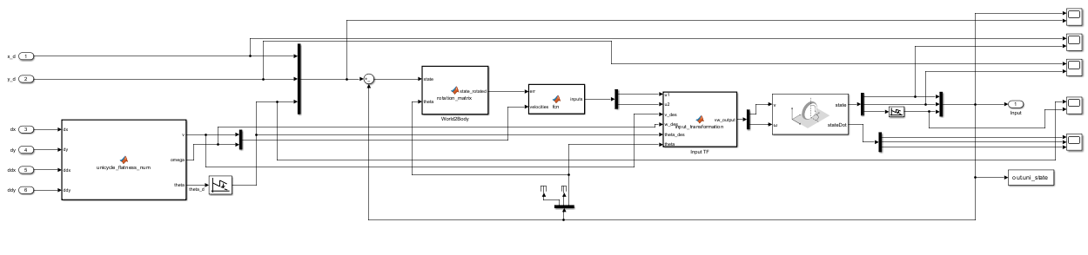
Non Linear case
Notes:
THINGS TO SAY:
General overview of the structure and vdes!=0 → same as before cause its related with diff flatness
Highlights the same nature of the structure, with the only difference : gain computation and feedback law
Barbalat’s lemma problem. Before we had no convergence guarantees cause k2 TV , now instead we could end up with loosing conv property cause w could become unbounded and hence Barb no true anymore -→ this is what we stress out in the sharp curve
explain the wrap / unwrap:
we used the unwrap to normalize theta angle, so we don't have the discontinuity going from 2pi to 0

Slide 18
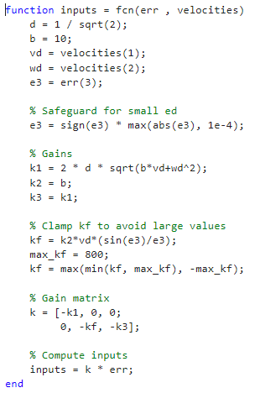
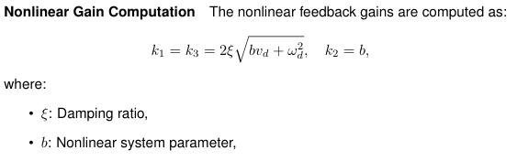
Gains & Parameters

Slide 19

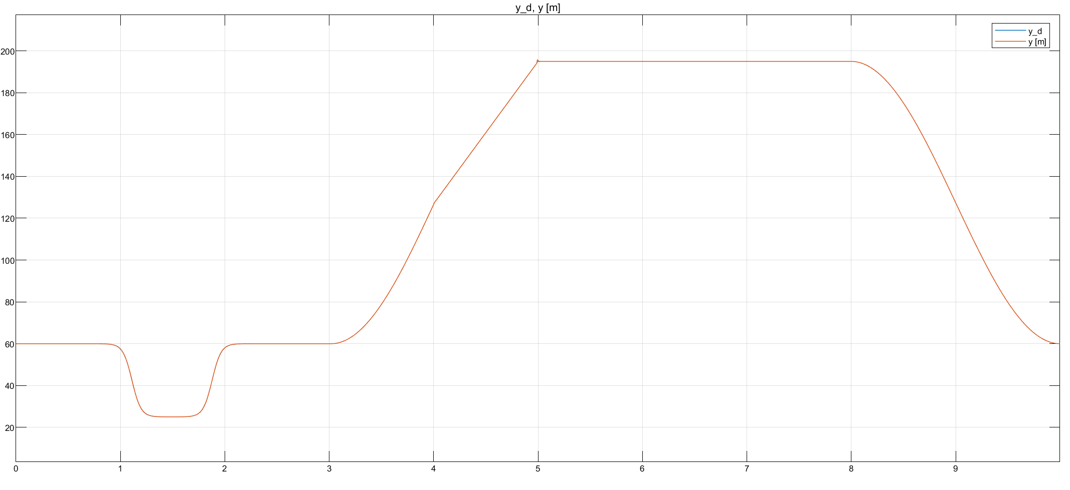

Slide 20
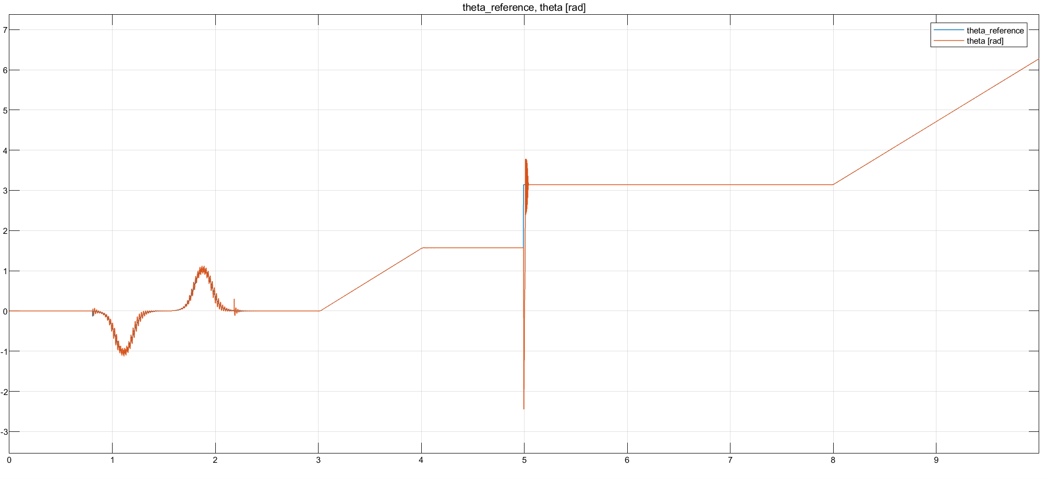
Plots --> see if impulse bigger than linear case follows some theoretical thing or just related to gains tuning

Slide 21
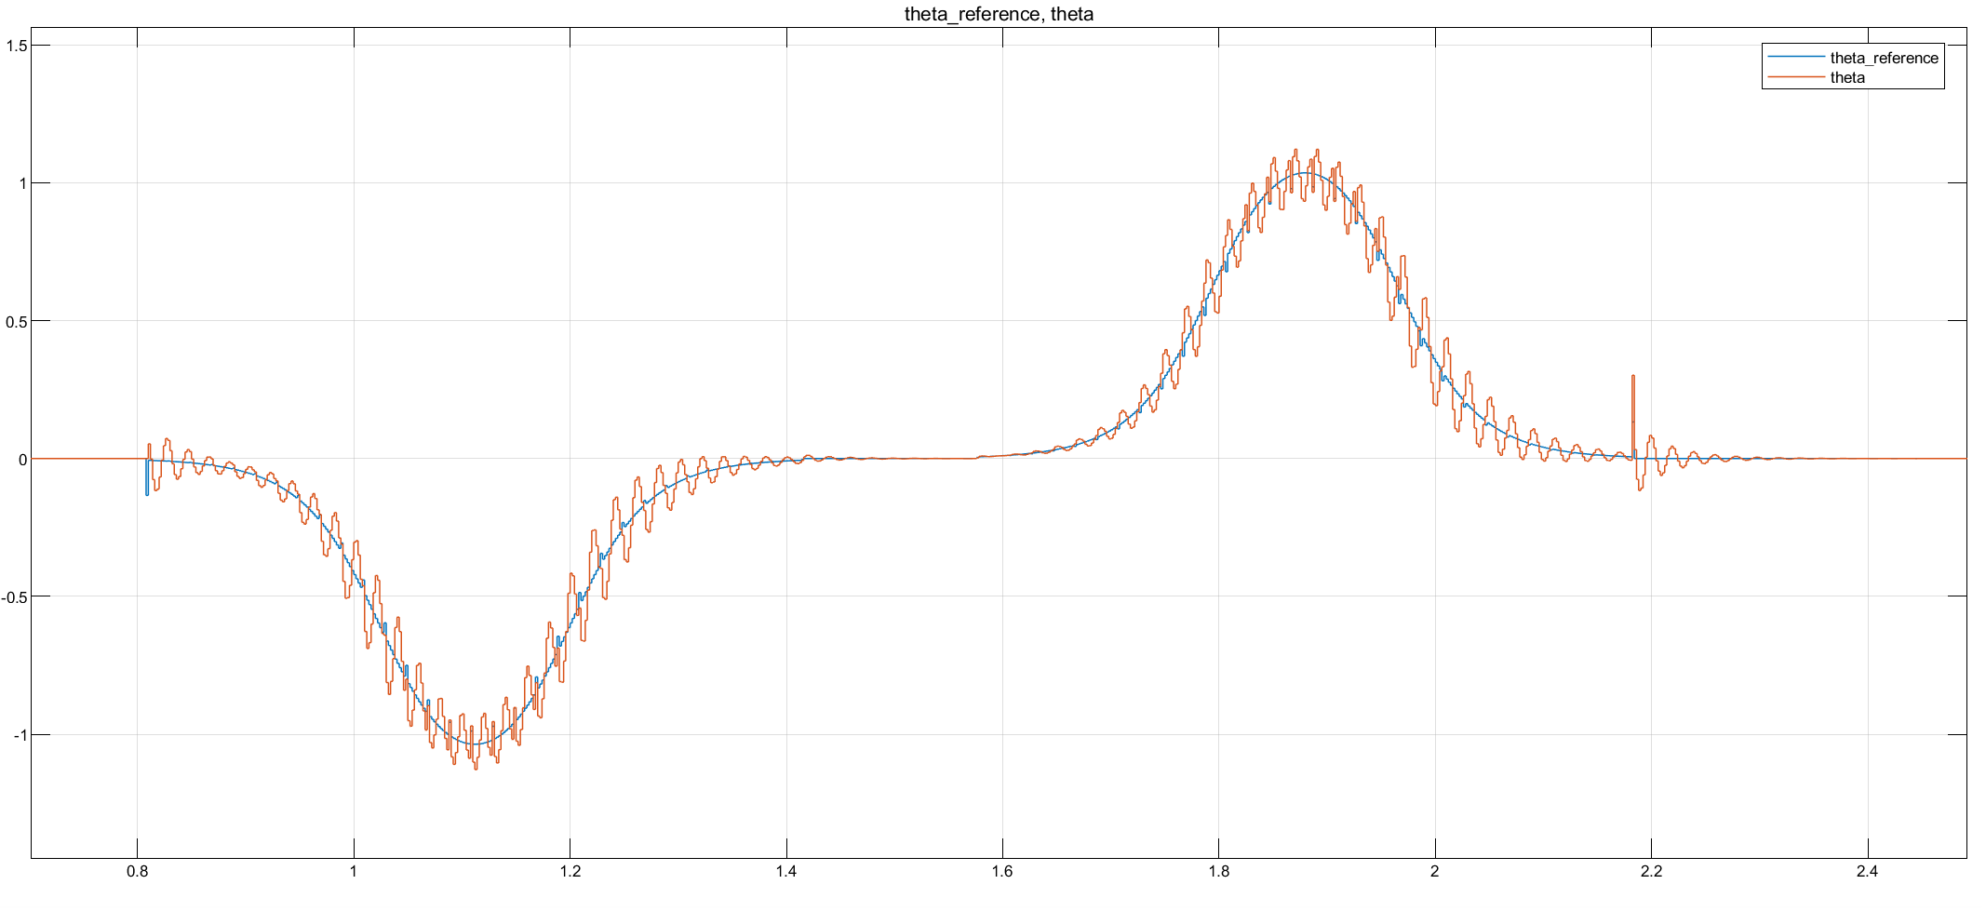

Slide 22
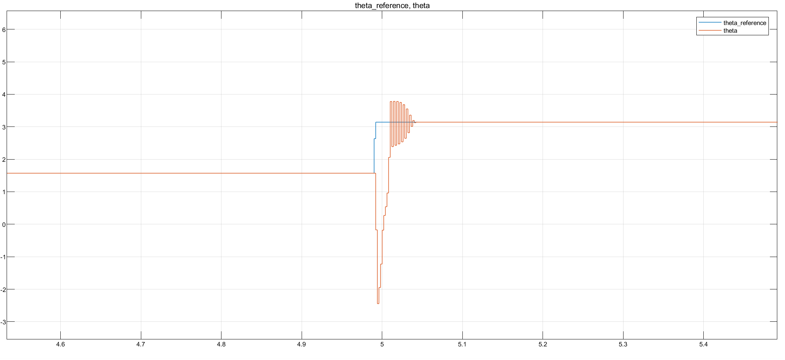
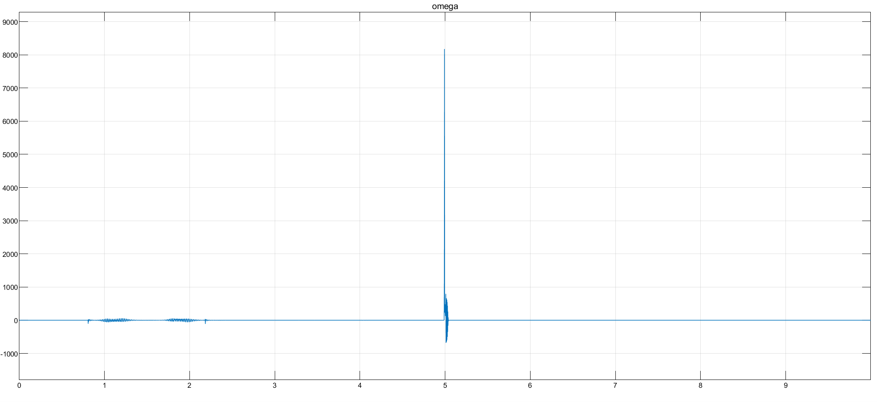
Focus on sharp curve
Make a consideration regarding NL more enhanced wrt lineare case, maybe theres a reason

Slide 23
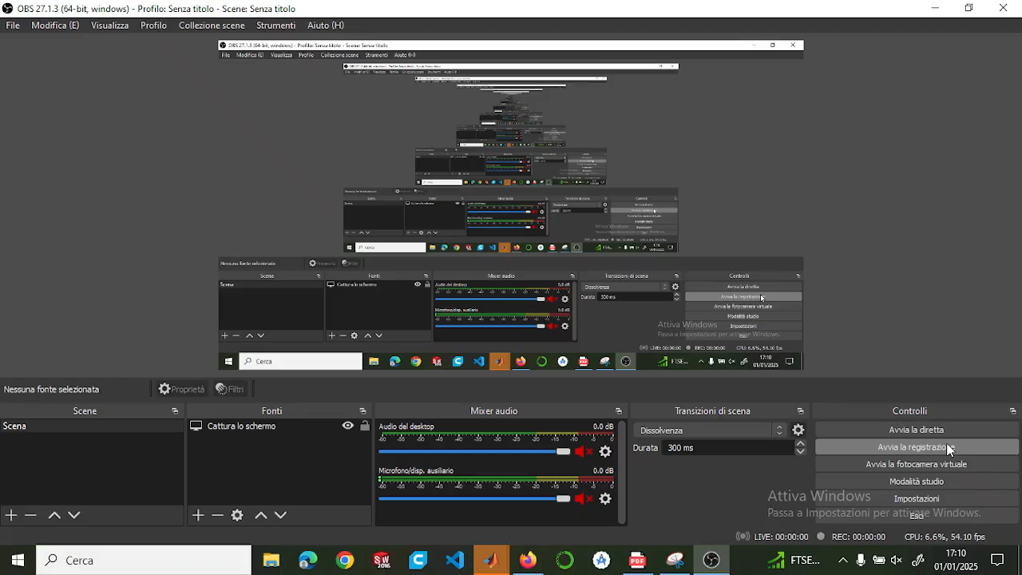
Video
Sistemare e tagliare video

Slide 24
Confronto tra linear e non linear nella zona sorpasso
+
Confronto tra linear e non linear nella zona curva a 90

Slide 25
Qualche breve considerazione finale sui due controllori, che poi verrà ripresa meglio alla fine della presentazione

Slide 26
TRAJECTORY TRACKING - OUTPUT ERROR FEEDBACK

Slide 27
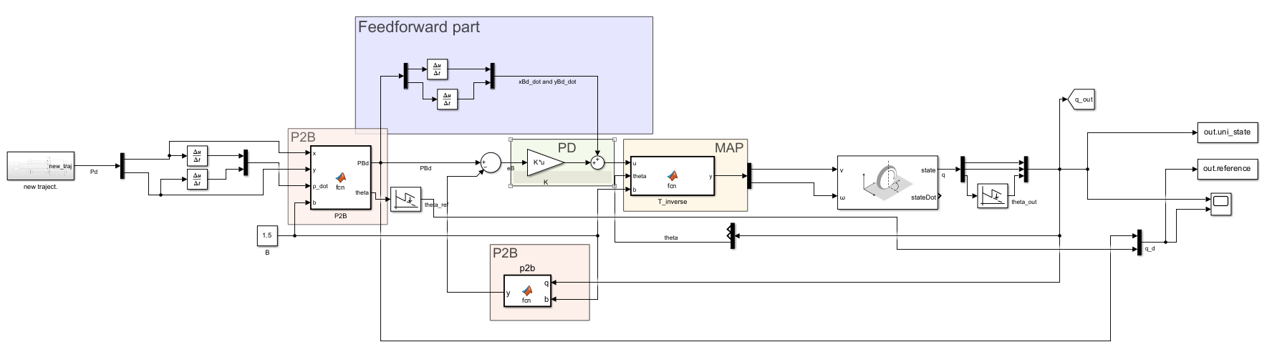
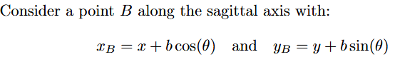
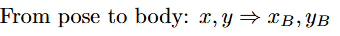
Feedback linearization based on a reference point on the sagittal axis

Slide 28
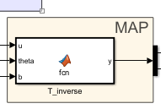
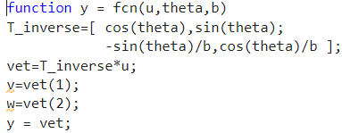
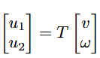
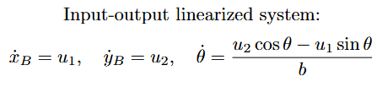
Map

Slide 29
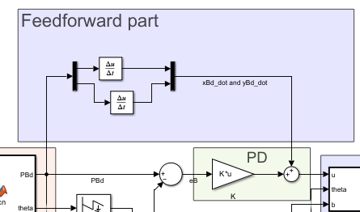
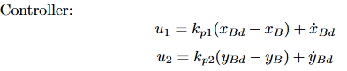
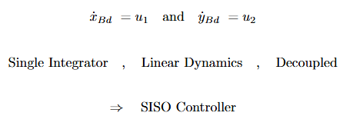
Controller design
Pro:

Slide 30
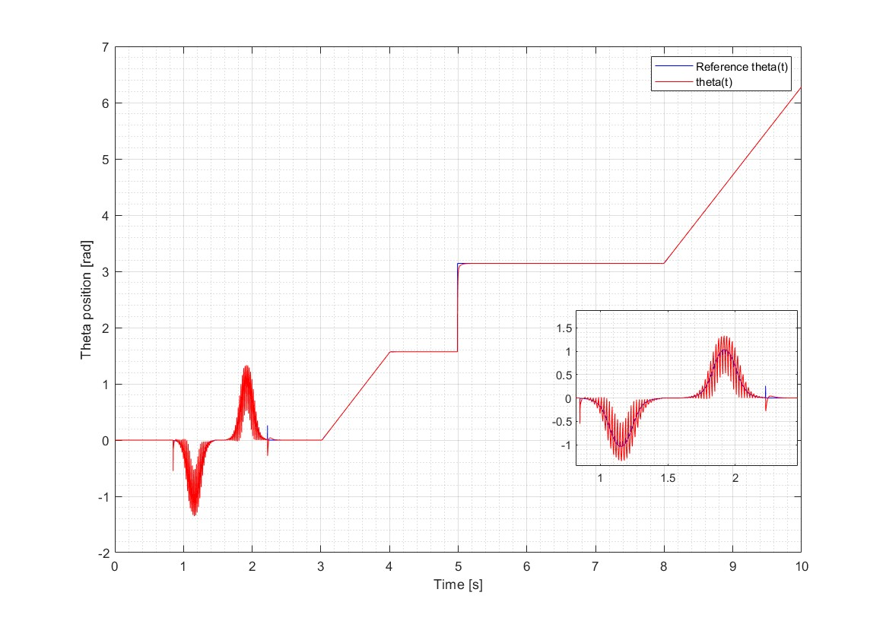
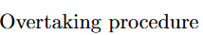
Plot

Slide 31
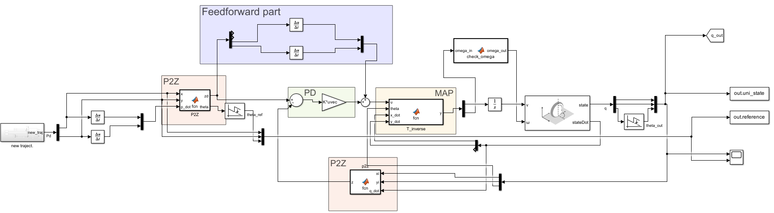
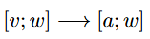
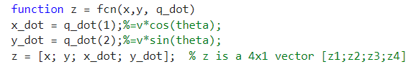
Feedback linearization based on second order derivatives

Slide 32
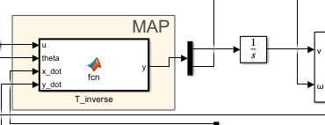
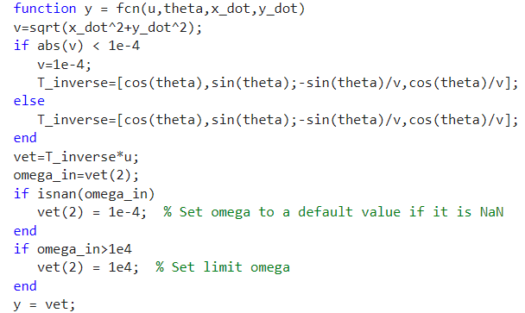
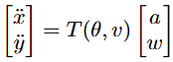
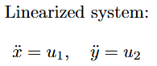
Map

Slide 33
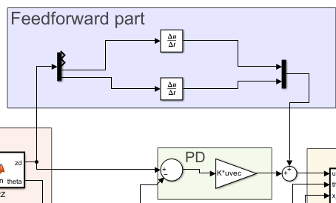


Controller design
Need:

Slide 34

Plot

Slide 35


Plot

Slide 36
REGULATION

Slide 37


Cartesian regulation

Slide 38



Control law

Slide 39

Pose regulation

Slide 40


State trasformation

Slide 41


Control law

Slide 42

Plots of all controllers together

Slide 43


Slide 44


